Slide 1

DAYANANDA SAGAR UNIVERSITY
SCHOOL OF ENGINEERING
Department of CSE
ARTIFICIAL INTELLIGENCE AND MACHINE LEARNING
INTELLIGENT SURVEILLANCE SYSTEM/SMART CAM
Under the Supervision
Prof. Vegi Fernando
Presented By:
CHETHAN S (ENG22AM0084)
GUDLA MONISH (ENG22AM0096)

Slide 2

Overview
Abstract
Problem Statement
Introduction
Social/Environmental Impact
Dept of CSE(AI&ML)., SOE-Dayananda Sagar University
*

Slide 3
Abstract
Security-centric video
Activates recording upon person detection
Minimises power and storage consumption.
Why this work - To create a smart and cheap security system by using computer vision to start recording only when person is detected, reducing unnecessary resource usage, which makes it a good business application
What you plan to do - We plan to create a video recording system using Python and OpenCV, leveraging computer vision algorithms to detect human presence in real-time. Upon detection, the system will initiate video recording, providing a robust and efficient solution for automated surveillance.
*

Slide 4
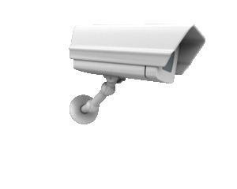
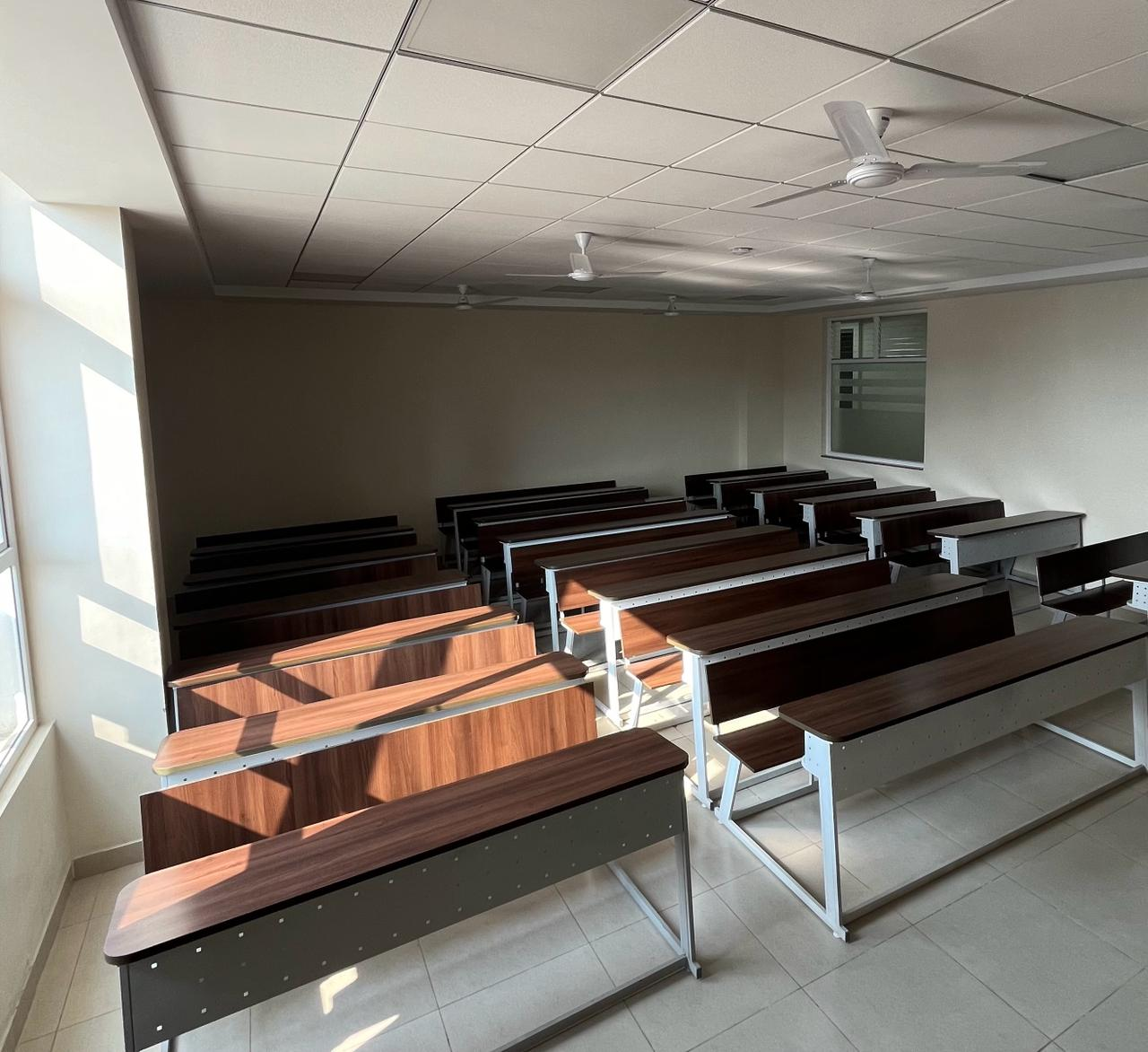
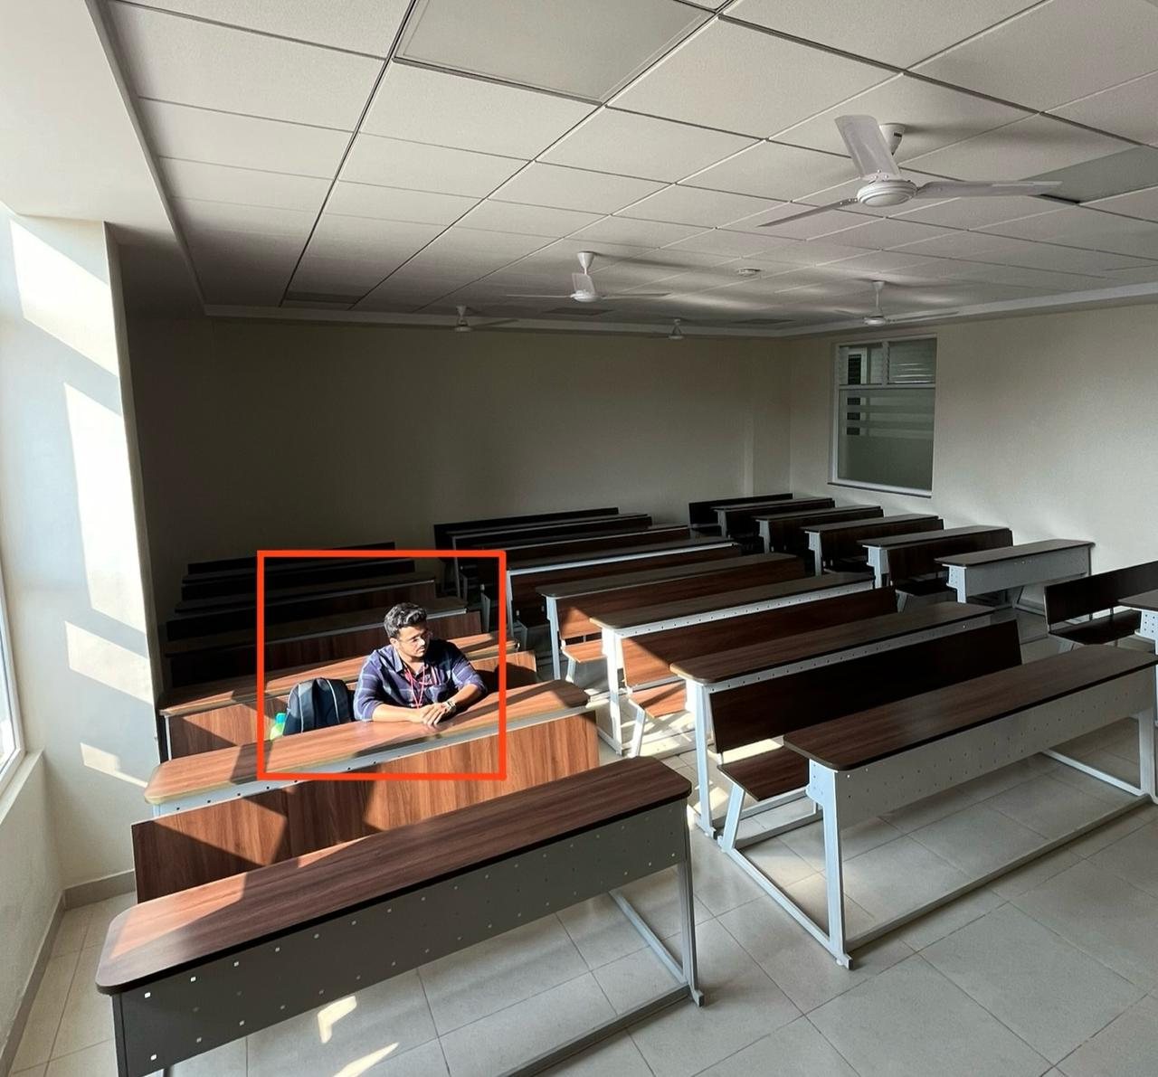
Approach and expected results
RECORDING OFF
RECORDING ON

Slide 5

Problem Statement
Problem: "Creating a security-oriented automated video recording system using computer vision to detect and record when a person is detected by the camera, thereby minimising power and storage consumption”.
Solution: "Designing a security-centric system that activates video recording upon person detection, optimising power and storage usage for efficient operation“.

Slide 6
Introduction
current status - understanding and building code
Scope of the project/Applications:
Home and business security
Environmental monitoring - such as wildlife observation
Baby Monitoring: Parents can use it as a baby monitor that only records when the baby is present, saving storage space
Event Recording: During events or conferences, the system can be used to automatically capture footage of speakers or attendees in specific areas
Patient monitoring: ensuring the safety and security of patients in their rooms
Construction Site Monitoring
*

Slide 7
Assumptions/Requirements
Stable Camera Placement: Assuming the camera is positioned in a stable location with a clear view,
Sufficient Lighting Conditions: Assuming sufficient lighting conditions for effective image processing
Consistent Performance: Assuming consistent performance of the hardware components, such as camera module.
Continuous Power Supply: Assuming access to a continuous power supply for camera module to maintain uninterrupted operation of the surveillance system.
Sufficient Processing Power: Assuming the System has sufficient processing power to perform real-time video processing and human detection using OpenCV without significant performance degradation.

Slide 8
Social/Environmental Impact
Environmental Impact:
Reduced Energy Consumption
Social impact:
Enhanced Security Awareness
Empowerment Through Technology
*

Slide 9
STATE OF THE ART-WORK
.
Paper Title/ Book Name and author names | Conference name and year | Technology used | Results | what we infer
1. Learning openCV , O'Reilly Media by G. Bradski and A. Kaehler | 2008 | OpenCV and Python Language | proficiency in using openCV | we got understanding of OpenCV library and derived our project idea from it
2.Home Monitoring and Security System," IEEE by S. Suresh, J. Bhavya, S. Sakshi, K. Varun, and G. Debarshi | International Conference on ICT in Business Industry & Government (ICTBIG), 2016 | utilizes camera modules and various sensors in conjunction with a microcontroller or microprocessor | results demonstrate the feasibility of the proposed economical home security system | The need for person detection and recording only when individuals are present(which it lacks)
3. "A Vision-Based Home Security System Using OpenCV on Raspberry Pi 3," AIP Publishing by T. Prathaban, W. Thean, and M.I.S. Mohd Sazali, | International Conference of Electrical and Electronic Engineering (ICon3E 2019), November 11, 2019 | OpenCV on Raspberry Pi 3 Model B | Achieving a 100% detection rate compared to a PIR motion sensor-based system with 76%, highlighting the potential of computer vision | we understood how exactly the opencv and camera module work together and modified the code to run without Raspberry Pi and on any camera module

Slide 10
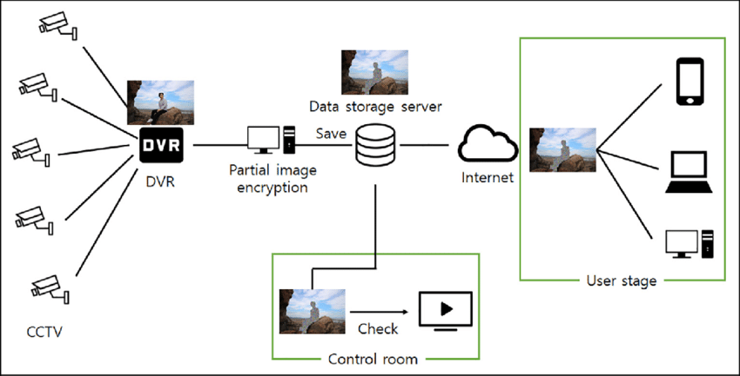
Proposed Model
This is the actual working of CCTV
Here both required and unrequited data is stored

Slide 11
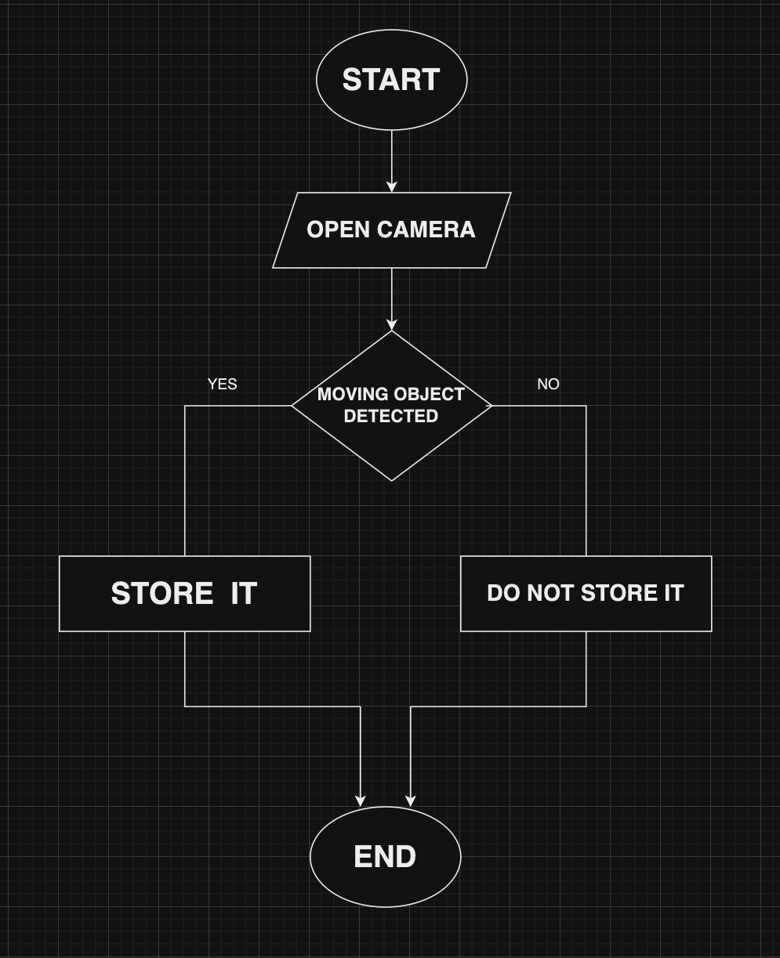
Design
This is the cctv model we are planing to build
Here wanted data is saved and unwanted data is deleted
RECORDING OFF
RECORDING ON

Slide 12
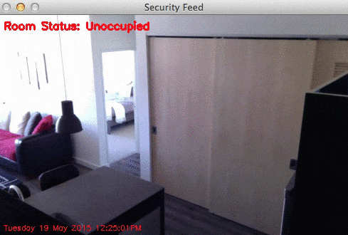
IMPLEMENTATION (detection part)
import cv2
cap = cv2.VideoCapture(0)
#initializing fgbg = cv2.createBackgroundSubtractorMOG2() #fgbg instance of GAUSSIAN
while cap.isOpened():
ret, frame = cap.read()
if not ret:
break
#applying fgmask = fgbg.apply(frame)
contours, _ = cv2.findContours(fgmask, cv2.RETR_EXTERNAL, cv2.CHAIN_APPROX_SIMPLE)
for contour in contours: #loop
if cv2.contourArea(contour) < 500: #less pixels i.e noise
continue
x, y, w, h = cv2.boundingRect(contour)
cv2.rectangle(frame, (x, y), (x + w, y + h), (0, 255, 0), 2)
cv2.imshow('Motion Detection', frame) #displays the original frame
if cv2.waitKey(1) & 0xFF == ord('q'):
break
cap.release()
cv2.destroyAllWindows()

Slide 13
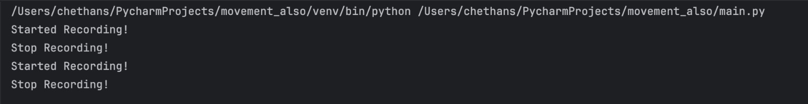
IMPLEMENTATION (recording part)
fgbg = cv2.createBackgroundSubtractorMOG2()
current_time = datetime.datetime.now().strftime("=Special_Topic-%d-%m-%Y-%H-%M-%S") #saving format
out = cv2.VideoWriter(f"{current_time}.mp4", fourcc, 20, frame_size)while cap.isOpened():
ret, frame = cap.read()
if not ret:
break
fgmask = fgbg.apply(frame)
contours, _ = cv2.findContours(fgmask, cv2.RETR_EXTERNAL, cv2.CHAIN_APPROX_SIMPLE)
movement_detected = any(cv2.contourArea(contour) > 500 for contour in contours) #recording part
[cv2.rectangle(frame, (x, y), (x + w, y + h), (0, 255, 0), 2) for contour in contours if cv2.contourArea(contour) > 500]
cv2.imshow('Motion Detection', frame)
if movement_detected:
out.write(frame)
if cv2.waitKey(1) & 0xFF == ord('q'):
break
cap.release()
out.release()
cv2.destroyAllWindows()

Slide 14
REFERENCES
G. Bradski and A. Kaehler, "Learning OpenCV," O'Reilly Media, 2008. [Online]. Available: https://www.oreilly.com/library/view/learning-opencv/9780596516130/
S. Suresh, J. Bhavya, S. Sakshi, K. Varun, and G. Debarshi, "Home Monitoring and Security System," IEEE, Apr. 6, 2017. [Online]. Available: https://ieeexplore.ieee.org/document/7892665, DOI: 10.1109/ICTBIG.2016.7892665
T. Prathaban, W. Thean, and M.I.S. Mohd Sazali, "A Vision-Based Home Security System Using OpenCV on Raspberry Pi 3," AIP Publishing, Nov. 11, 2019. [Online].Available: https://pubs.aip.org/aip/acp/article/2173/1/020013/746630/A-vision-based-home-security-system-using-OpenCV DOI: [10.1063/1.5133928] (https://doi.org/10.1063/1.5133928)
*

